Slide 1

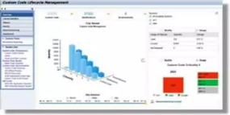
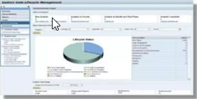
CUSTOM CODE MIGRATION PROCESS
Step 1: Custom Code Evaluation
Transparency with Custom Code Lifecycle Management (CCLM)
Monitor usage of your custom code via Usage and Procedure Logging (UPL)
Use Usage data to prioritize your custom code efforts
Remove Waste with CCLM decommissioning cockpit
Remove unused code before the S/4HANA conversion

Slide 2
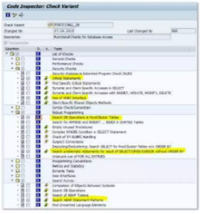
CUSTOM CODE MIGRATION PROCESS
Step 2: Code Inspector Checks for SAP HANA
Code Inspector checks for SAP HANA verify whether your custom code
Uses DB-specific features like native SQL, DB hints or ADBC
Relies on not guaranteed or implicit sorting of database queries
Performs DB Operations on physical pool/cluster database tables
Uses function modules to retrieve technical DB index information
Recommendation
Run code Inspector variant FUNCTIONAL_DB for your custom code
Fix all errors and warnings (findings with priority 1 and 2)

Slide 3
CUSTOM CODE MIGRATION PROCESS
Step 3: SAP S/4HANA Custom Code Analysis Process

Slide 4
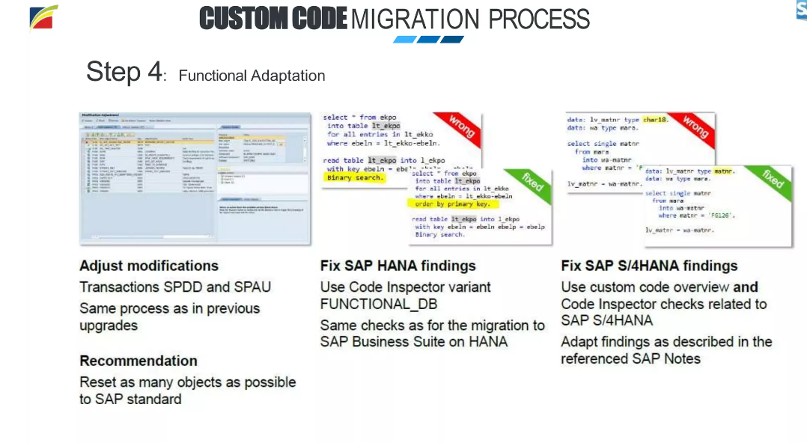

Slide 5
